Slide 1
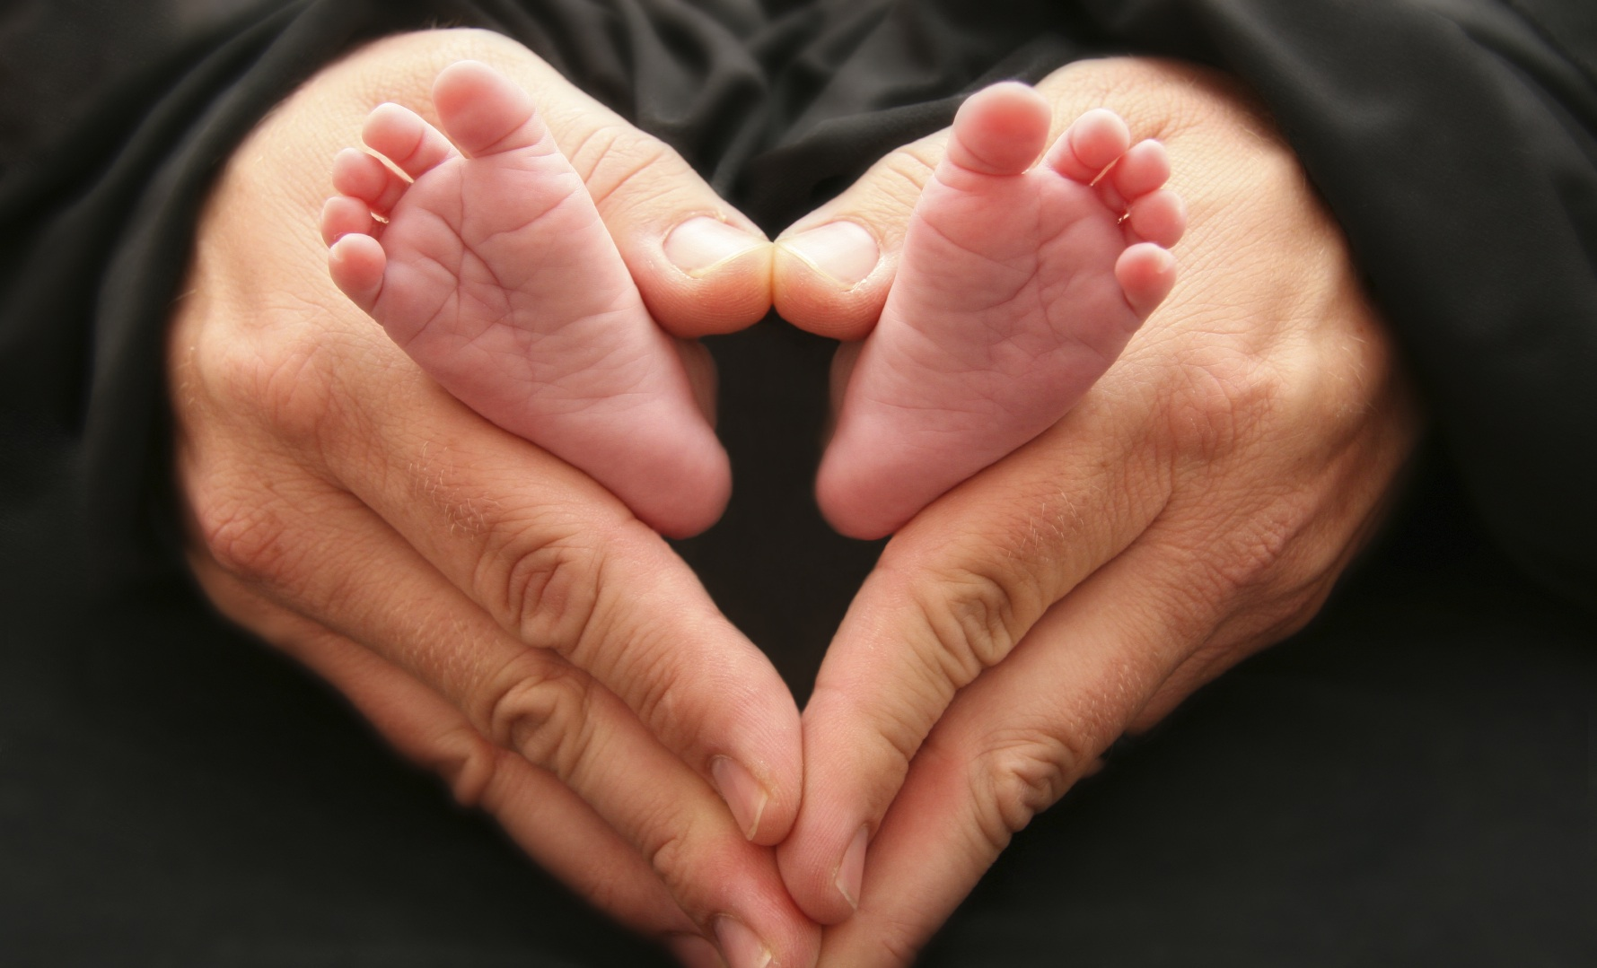
knowledge about abortion
An Amárach Research Briefing May 2017

Slide 2
Methodology
The questions analysed in this report were included in Amárach’s monthly online omnibus poll of 1,000 adults aged 16 and over.
The research reported here is based on findings from omnibus fieldwork was conducted in May 2017.
The questions relating to abortion were asked of those aged 18 and over in the survey (998 adults).
Weighting was applied to make them representative of the total adult population in Ireland, in accordance with standard sampling practice.

Slide 3
Current Knowledge – I
Q: If you were to estimate, what proportion of pregnancies would you say end in abortion in England and Wales? base: all adults 18+
Only 1 in 20 Irish people know the actual incidence of abortion in England & Wales.
Although 1 in 4 claim not to know, the majority already have an impression as to the incidence of abortion in England & Wales, whether accurate or not.

Slide 4
Current Knowledge – II
Q: If you were to estimate, what proportion of pregnancies would you say end in abortion in England and Wales?? base: all adults 18+
May 2017 | TOTAL | Male | Female | 18-24 | 25-34 | 35-44 | 45-54 | 55+
 | 998 | 493 | 505 | 119 | 220 | 200 | 170 | 290
Roughly 1 in 50 pregnancies end in abortion | 20% | 17% | 22% | 18% | 18% | 18% | 21% | 22%
Roughly 1 in 35 pregnancies end in abortion | 16% | 14% | 17% | 22% | 12% | 19% | 13% | 15%
Roughly 1 in 25 pregnancies end in abortion | 21% | 20% | 23% | 25% | 26% | 19% | 20% | 19%
Roughly 1 in 10 pregnancies end in abortion | 13% | 16% | 11% | 13% | 15% | 13% | 15% | 12%
Roughly 1 in 5 pregnancies end in abortion | 6% | 7% | 6% | 7% | 6% | 4% | 8% | 6%
Do not know | 24% | 26% | 21% | 15% | 24% | 27% | 22% | 26%
Source: Amárach Research, May 2017

Slide 5
Current Knowledge – III
Q: If you were to estimate, what percentage of pregnancies involving an unborn baby diagnosed with Down Syndrome would you say are aborted in England and Wales? base: all adults 18+
Only 1 in 10 Irish people know the actual incidence of abortion in England & Wales in cases involving Down Syndrome.
Although 3 in 10 claim not to know, the majority already have an impression as to the incidence of abortion in pregnancies involving Down Syndrome.

Slide 6
Current Knowledge – IV
Q: If you were to estimate, what percentage of pregnancies involving an unborn baby diagnosed with Down Syndrome would you say are aborted in England and Wales? base: all adults 18+
May 2017 | TOTAL | Male | Female | 18-24 | 25-34 | 35-44 | 45-54 | 55+
 | 998 | 493 | 505 | 119 | 220 | 200 | 170 | 290
Roughly 20% of pregnancies involving Down Syndrome are aborted | 22% | 18% | 25% | 23% | 17% | 19% | 25% | 25%
Roughly 35% of pregnancies involving Down Syndrome are aborted | 20% | 16% | 23% | 28% | 25% | 20% | 13% | 15%
Roughly 60% of pregnancies involving Down Syndrome are aborted | 18% | 19% | 17% | 21% | 18% | 16% | 16% | 18%
Roughly 90% of pregnancies involving Down Syndrome are aborted | 10% | 13% | 7% | 7% | 11% | 13% | 11% | 8%
Don’t know | 31% | 33% | 28% | 21% | 29% | 31% | 34% | 34%
Source: Amárach Research, May 2017

Slide 7
Findings Overview
As the debate about the 8th Amendment gathers pace, there is clearly a significant knowledge gap in relation to the incidence of abortion in England & Wales.
Irish women and young people are more likely to underestimate the incidence of abortion in England & Wales than older people: though the latter significantly underestimate it as well.
While people are more ’accurate’ in estimating the incidence of abortion in the case of pregnancies involving Down Syndrome, the fact remains that the vast majority still underestimate the actual incidence rate in England & Wales.

Slide 8
e. info@amarach.com w. www.amarach.com
b. www.amarach.com/blog
t. twitter.com/AmarachResearch

