Slide 1
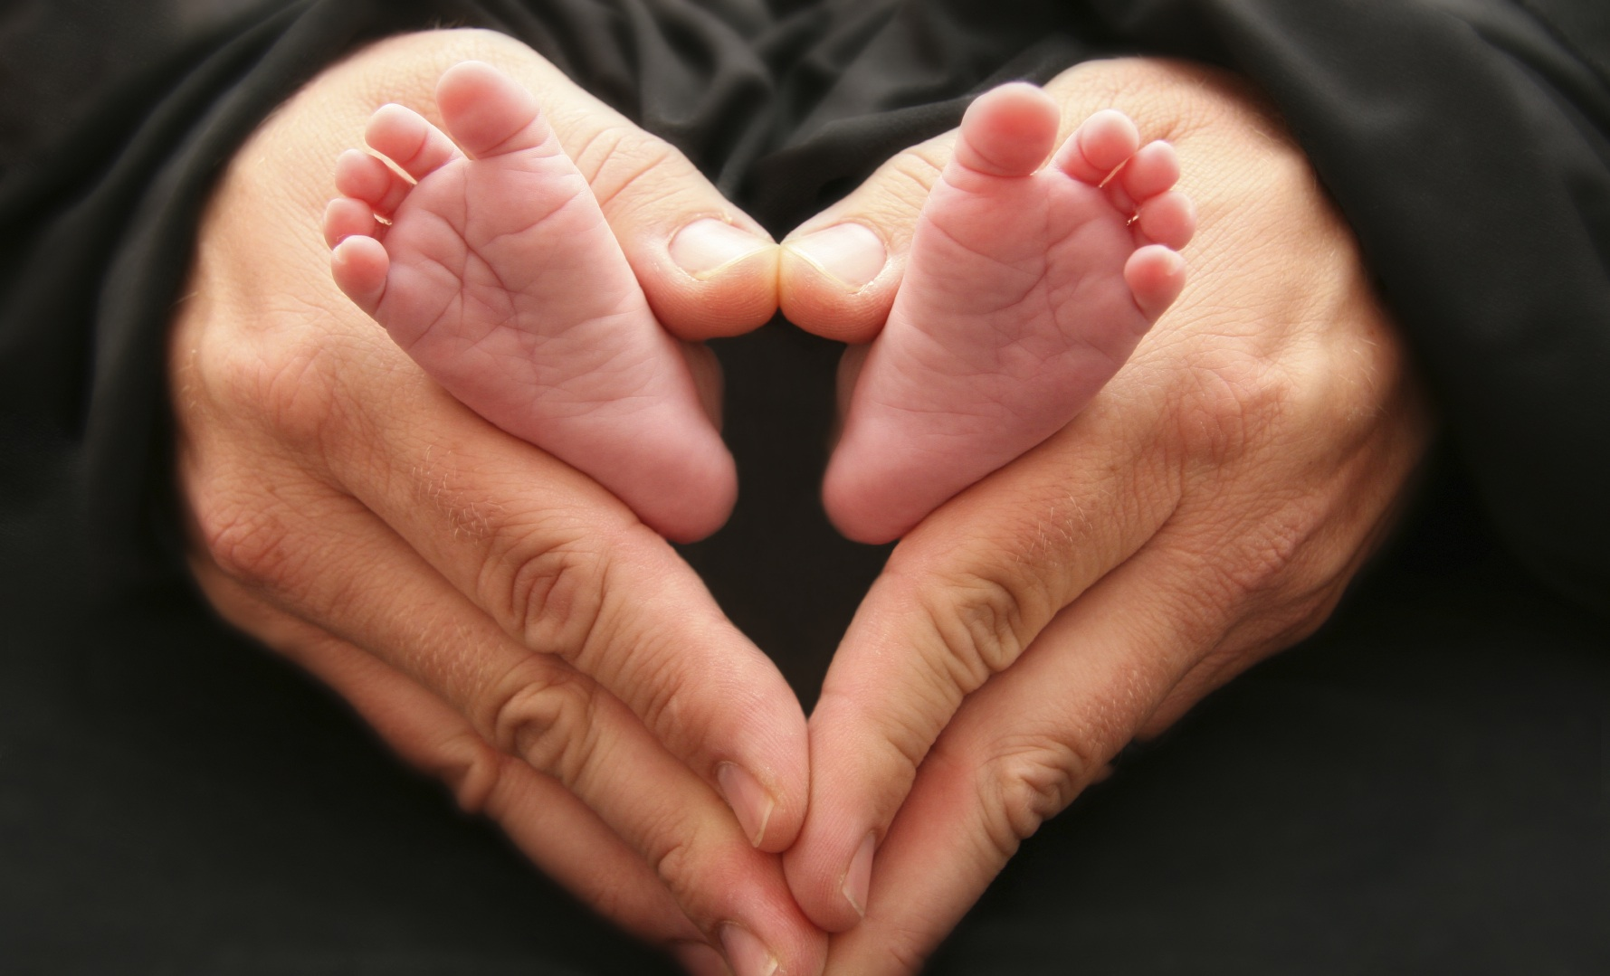
Attitudes to Abortion
An Amárach Research Briefing January 2016

Slide 2
Methodology
The questions analysed in this report were included in Amárach’s monthly online omnibus poll of 1,000 adults aged 16 and over.
The most recent omnibus fieldwork was conducted during 11th-18th January 2016 inclusive.
The questions relating to abortion were asked of those aged 18 and over in the survey (997 adults).
Weighting was applied to make them representative of the total adult population in Ireland, in accordance with standard sampling practice.

Slide 3
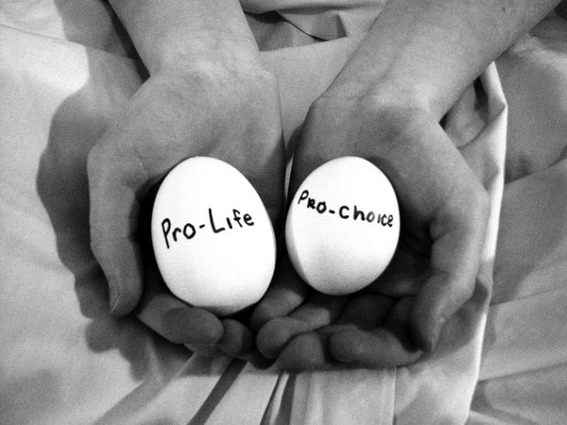
Current Attitudes

Slide 4
Current Attitudes I
Q: Which of the following best describes your position on abortion? base: all adults 18+
The percentage of adults in favour of legalising abortion in Ireland remains unchanged since 2014.
As before, older age groups are more likely to be against, however, it is noticeable that 18-25s are more undecided than other age groups (see next slide).
People likely to give their first preference vote (in a General Election) to Sinn Fein are more likely to be in favour than those who would give their first preference to Fianna Fail.

Slide 5
Current Attitudes II
Q: Which of the following best describes your position on abortion? base: all adults 18+
January 2016 | TOTAL | Male | Female | 18-24 | 25-34 | 35-44 | 45-54 | 55+ | Fine Gael | Fianna Fail | Sinn Fein
 | 994 | 493 | 501 | 163 | 223 | 187 | 156 | 265 | 113 | 74 | 99
In Favour | 57% | 55% | 58% | 61% | 64% | 56% | 55% | 49% | 53% | 50% | 65%
Opposed | 25% | 26% | 24% | 18% | 22% | 25% | 28% | 31% | 27% | 35% | 29%
Undecided | 18% | 19% | 17% | 22% | 14% | 19% | 17% | 19% | 20% | 15% | 6%
Source: Amárach Research, January 2016

Slide 6
Abortion & Suicide I
Q: If it were medically shown that abortion is not a treatment for suicidal feelings and that abortion itself may pose mental health risks for women, would you be: base: all adults 18+
About one in four adults would be less likely to support abortion in relation to the treatment of suicidal feelings in this scenario.
Men and people aged 45-54 would be less likely than others (see next slide).
Fianna Fail and Sinn Fein supporters would be less likely than Fine Gael supporters.

Slide 7
Abortion & Suicide II
Q: If it were medically shown that abortion is not a treatment for suicidal feelings and that abortion itself may pose mental health risks for women, would you be: Base: all adults 18+
January 2016 | TOTAL | Male | Female | 18-24 | 25-34 | 35-44 | 45-54 | 55+ | Fine Gael | Fianna Fail | Sinn Fein
 | 994 | 493 | 501 | 163 | 223 | 187 | 156 | 265 | 113 | 74 | 99
More likely to support | 17% | 18% | 16% | 13% | 20% | 20% | 17% | 17% | 22% | 23% | 19%
Less likely to support | 25% | 28% | 23% | 25% | 25% | 26% | 32% | 21% | 23% | 35% | 30%
Make no difference | 57% | 54% | 61% | 62% | 55% | 54% | 51% | 63% | 56% | 42% | 52%
Source: Amárach Research, January 2016

Slide 8
Abortion & Politics

Slide 9
Government Priorities I
Q: Do you think the Government should prioritise: base: all adults 18+
The adult population is quite evenly split in relation to their preferences for government policy in relation to babies with life-limiting conditions.
Women are more likely to support resourcing proper are than men, as are older adults (see next slide).
A majority of Fianna Fail supporters would prefer resourcing care over legal change.

Slide 10
Government Priorities II
Q: Do you think the Government should prioritise: Base: all adults 18+
January 2016 | TOTAL | Male | Female | 18-24 | 25-34 | 35-44 | 45-54 | 55+ | Fine Gael | Fianna Fail | Sinn Fein
 | 994 | 493 | 501 | 163 | 223 | 187 | 156 | 265 | 113 | 74 | 99
Making it legal | 52% | 55% | 50% | 55% | 59% | 51% | 47% | 50% | 53% | 47% | 51%
Resourcing proper care | 48% | 45% | 50% | 45% | 41% | 49% | 53% | 50% | 47% | 53% | 49%
Source: Amárach Research, January 2016

Slide 11
Electoral Preferences I
Q: In the upcoming General Election, would you be more inclined to vote for a candidate who: base: all adults 18+
Twice as many adults say they would be more likely to vote for a candidate who supports removing the 8th Amendment than keeping it – though nearly 4 in 10 are undecided on the matter.
Older adults and Fianna Fail supporters are more likely than the total population to vote for candidates who support keeping the 8th Amendment (see next slide).

Slide 12
Electoral Preferences II
Q: In the upcoming General Election, would you be more inclined to vote for a candidate who: Base: all adults 18+
January 2016 | TOTAL | Male | Female | 18-24 | 25-34 | 35-44 | 45-54 | 55+ | Fine Gael | Fianna Fail | Sinn Fein
 | 994 | 493 | 501 | 163 | 223 | 187 | 156 | 265 | 113 | 74 | 99
Supports keeping 8th Amendment | 21% | 20% | 23% | 14% | 17% | 24% | 26% | 24% | 24% | 31% | 29%
Supports removing 8th Amendment | 42% | 45% | 40% | 53% | 46% | 33% | 35% | 43% | 43% | 41% | 45%
Don’t know/ not sure | 37% | 36% | 38% | 34% | 36% | 43% | 39% | 33% | 33% | 29% | 26%
Source: Amárach Research, January 2016

Slide 13
Referendum I
Q: If you were to guess how your closest neighbour would vote in a referendum on the repeal of the 8th Amendment on protection for the unborn; would he or she vote in favour of repealing the 8th Amendment or vote against repealing the 8th Amendment? base: all adults 18+
While most people are unsure who their neighbours would vote, among the rest more expect their neighbours to vote against repeal of the 8th Amendment than for its repeal.
Both Fianna Fail and Sinn Fein voters would expect significantly more to vote against repeal than for it (see overleaf).
If we exclude don’t knows (slide Referendum III) then the expectation is that a referendum to repeal the 8th amendment would be defeated.

Slide 14
Referendum II
Q: If you were to guess how your closest neighbour would vote in a referendum on the repeal of the 8th Amendment on protection for the unborn; would he or she vote in favour of repealing the 8th Amendment or vote against repealing the 8th Amendment? base: all adults 18+
January 2016 | TOTAL | Male | Female | 18-24 | 25-34 | 35-44 | 45-54 | 55+ | Fine Gael | Fianna Fail | Sinn Fein
 | 994 | 493 | 501 | 163 | 223 | 187 | 156 | 265 | 113 | 74 | 99
Likely to vote in favour of repeal | 25% | 28% | 21% | 28% | 30% | 25% | 22% | 20% | 36% | 26% | 23%
Likely to vote against repeal | 28% | 27% | 30% | 31% | 26% | 25% | 29% | 31% | 25% | 41% | 35%
Don’t know/ not sure | 47% | 45% | 49% | 41% | 44% | 50% | 49% | 50% | 39% | 33% | 42%
Source: Amárach Research, January 2016

Slide 15
Referendum III
Q: If you were to guess how your closest neighbour would vote in a referendum on the repeal of the 8th Amendment on protection for the unborn; would he or she vote in favour of repealing the 8th Amendment or vote against repealing the 8th Amendment? base: all adults 18+ EXCLUDING DON’T KNOWS
January 2016 | TOTAL | Male | Female | 18-24 | 25-34 | 35-44 | 45-54 | 55+ | Fine Gael | Fianna Fail | Sinn Fein
 | 994 | 493 | 501 | 163 | 223 | 187 | 156 | 265 | 113 | 74 | 99
Likely to vote in favour of repeal | 47% | 51% | 42% | 48% | 54% | 50% | 44% | 39% | 59% | 39% | 40%
Likely to vote against repeal | 53% | 49% | 58% | 52% | 46% | 50% | 56% | 61% | 41% | 61% | 60%
Source: Amárach Research, January 2016

Slide 16
Findings Overview
Attitudes in general towards abortion have not changed significantly in the past few years, with a majority in favour of further changes to legalise abortion.
Using a ‘wisdom of crowds’ question format to elicit how people think the general population would vote in a referendum on the 8th amendment (thereby removing the ‘signalling bias’ inherit in questions about people’s own voting intentions) we get a very different scenario.
When it comes to the issue of a referendum to repeal the 8th amendment (if held now), our survey predicts that efforts to repeal the 8th would be defeated 53%/47% (n.b.: the same question format predicted a 60%/40% win for the Yes campaign three months before last year’s marriage referendum).
Women, under 25s/over 55s and Fianna Fail/Sinn Fein voters would be most likely to vote against repeal of the 8th amendment.

Slide 17
e. info@amarach.com w. www.amarach.com
b. www.amarach.com/blog
t. twitter.com/AmarachResearch

